Slide 1

The Silent Goodbye
Predicting SyriaTel Customer Attrition through Advanced Machine Learning Classifiers
Kamau Waithaka
Moringa School Consulting

Slide 2
Presentation Outline
01
Project Overview
04
Modelling
02
EDA
05
Insights
03
Methodology
06
Recommendations

Slide 3






Project Overview
Business Case.
Syriatel experiencing customer exits affecting revenue.
Exits are silent and reflect overtime.
Solve the problem by data driven solution before exits happen
Business Case
Understanding customer attrition.
Developing targeted retention intervention .
Build ML prediction classifier.
Key Objectives.
Build a reliable model to predict exit.
Evaluate the model performance.
Identify key exit drivers
Propose Retention strategy
Prevent before they even know!.

Slide 4
Load, Explore, Clean
Load.
Necessary libraries were loaded .
The dataset “syria_tel.csv” was used for the analysis
Python Language on Jupyter Notebook platform.
Explore
The data had 3,333 rows and 21 columns.
Data had float, Bolean, float and integers .
No duplicates and missing data
Clean.
Dropping redundant columns
Converting into customer usage patterns and rations
Adding missing columns.
Creating column to check customer behaviour
Analyze what you know!

Slide 5

Data Exploration

Slide 6
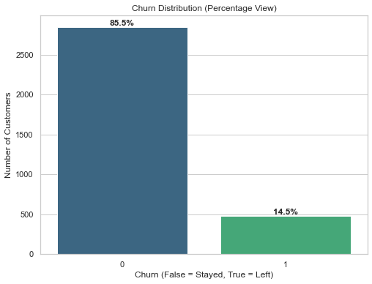
Data Imbalance
Significantly imbalanced with 85.5% non-exits and 14.5% exits.
Creates bias in prediction models towards majority class(stays) affecting detection of actual exits.
Fix this with recall and F1-score rather than focusing on accuracy.
•

Slide 7
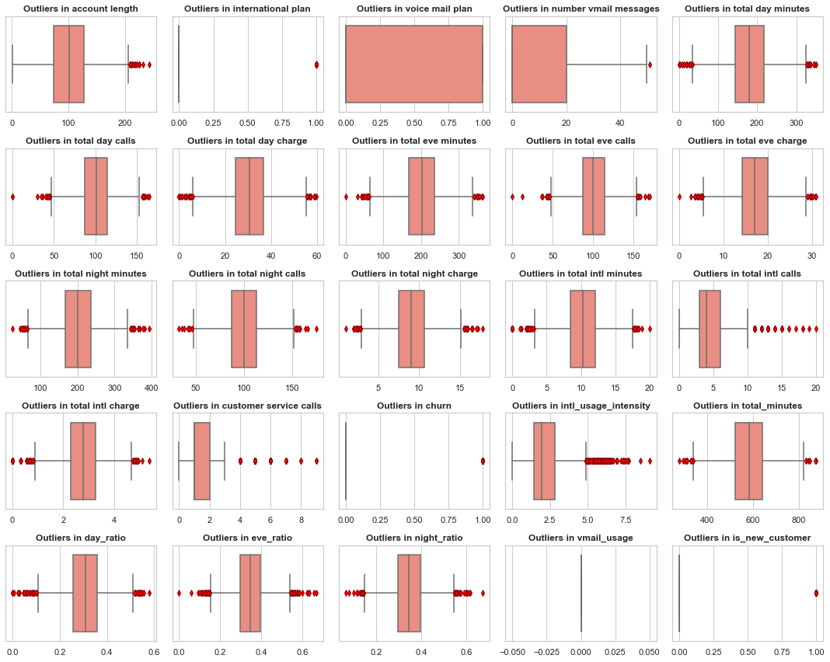
Checking Outliers
Customer service calls is rightly skewed, with an outlier of 9 calls.
20 international calls, high value customer.
Account length = loyalty, legacy customers.
Massive spike at vmail messages at zero.
Many Outliers in day time minutes

Slide 8
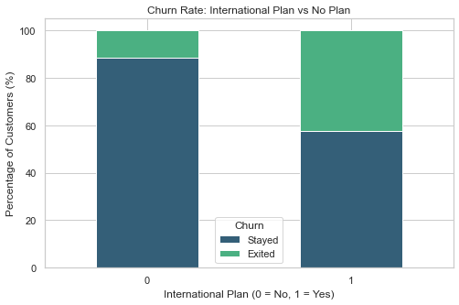
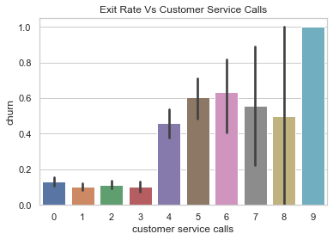
Exit rate Vs Int. plan and Customer Service Calls
Majority do not have international plan.
Int. plan customer x4times likely to exit at 42%
Customers interactions corelated significantly with exit. Early warning signal?

Slide 9
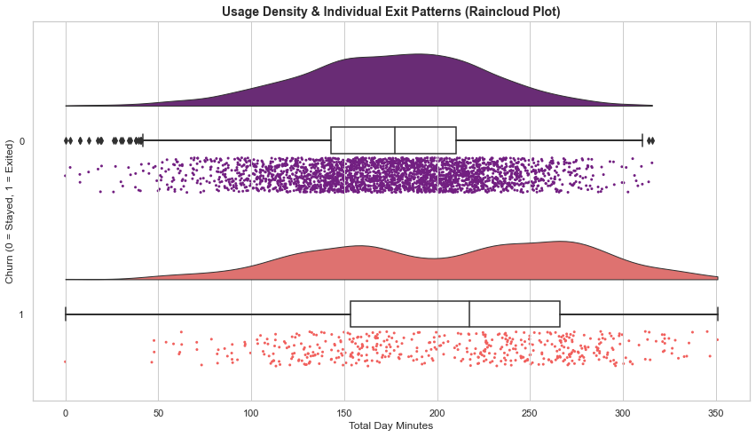
Total Day usage patterns vs Exits
High usage customers in two humps at 160 and at 270 minutes vulnerable to exit.
Loyalty 150-180 minutes, beyond 250 likely to exit.
Daytime usage of around 220 minutes, beyond likely to exit.
Higher usage customer exiting? Billing or service quality?

Slide 10
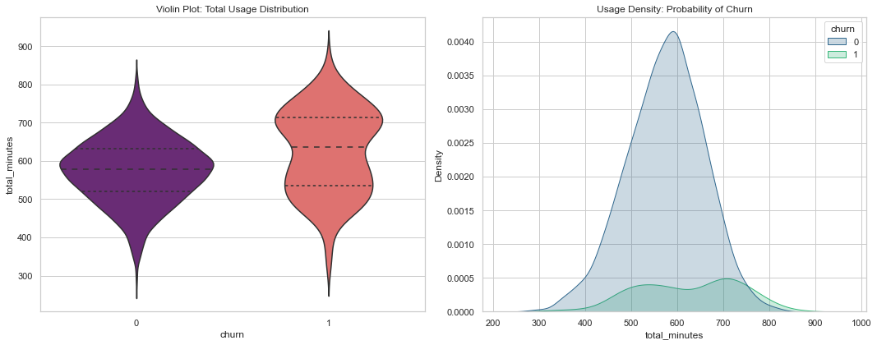
Total usage patterns vs Exits
Statistical threshold on the (right), when loyalty ends beyond 600minutes.
Safe zone in the violin (left) at between 500-600minutes.
Customer retention of safe bulk zone is imperative

Slide 11
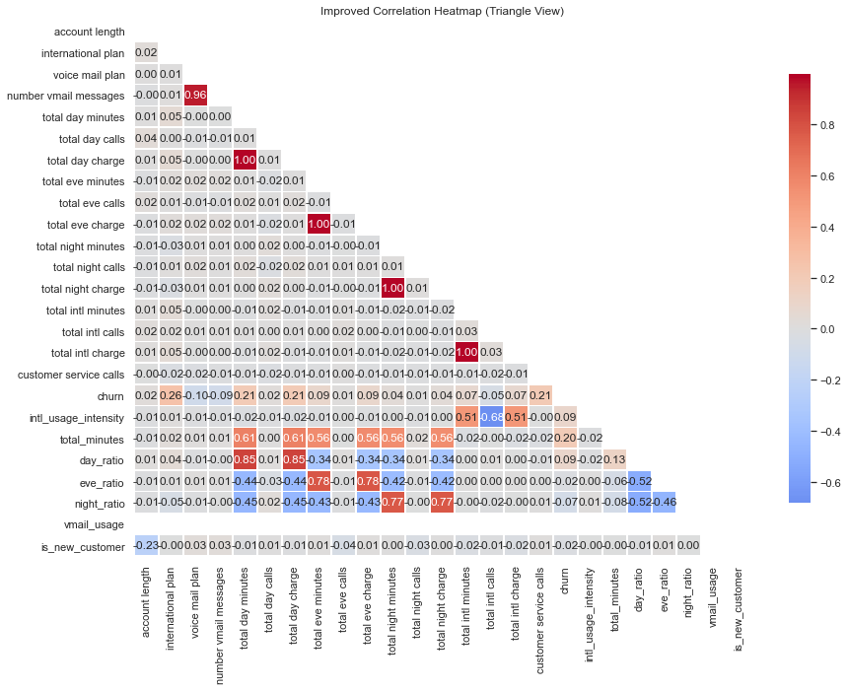
Correlation Heat Map.
The bright red spot of 1.0% and 96% show multicollinearity.
The colored 'Churn' row shows the key drivers of exits.
Feature engineering to get ratios and usage intensity.

Slide 12


The data exploratory summary show that customer exits directly correlate to
a) Service dissatisfaction.
b) Usage pattern and behavior.
c) Service plan characteristics.
The dataset is imbalanced, necessitating.
Feature selection on usage and charge variables to avoid redundancy.
•

Slide 13

Data Modeling

Slide 14
Leveling the Playing Field
Select
Target y = ['churn']
Feature X = .drop(columns=['churn'])
Split.
Split-Train , Train-Test Split
Balance.
Correct the imbalance, focus on Customers exiting.
Focus on Recall and F1 rather than accuracy
Set the scene for modelling

Slide 15






Modeling the exit Path
Logistic Regression
Decision Tree
Hyperparameter Tuning
The Linearity Checker
The Pattern Finder
The Optimization Tool

Slide 16

Models Evaluation

Slide 17
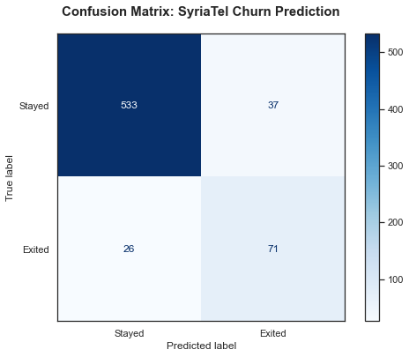
Confusion Matrix
Predicted 533 loyal customers would stay.
71 customers would exit and hence caught them.
Captures 73% of actual customer exits (71 out of 97).
Focus on efficiency: No need to focus on 37 loyal customers who were incorrectly flagged.
Targeted intervention: For every 108/ 71 are confirmed leavers.
Allows targeted to a highly surgical data driven outreach.
•

Slide 18
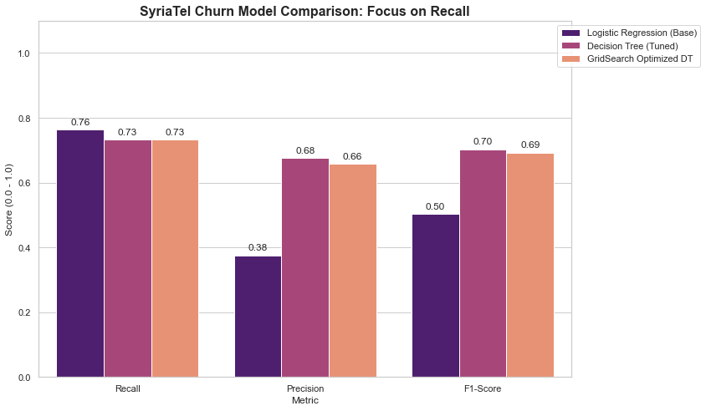
What works best?
The Decision Tree (Tuned), highest F1-Score of 0.70.
Recall of 0.73 identifies 73% of customer exits.
The model flags 68% of customers for retention.
Logistic Regression higher recall of 76%, low precision 38%.
LR waste of resources compared the Tuned Decision Tree.

Slide 19
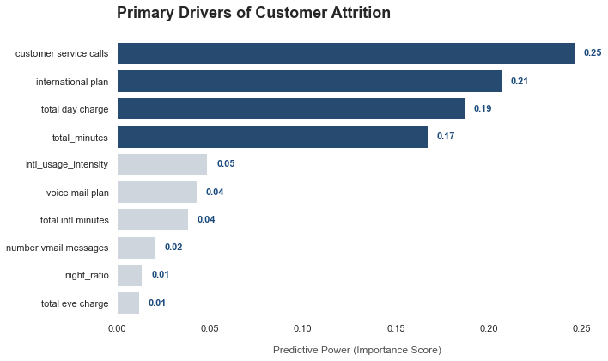
Early Warning Signals?
Key drivers of Customer exiting
Customer service calls at 24%.
International plan 20%.
Total minutes 16% total charges at 18%
Important to classify type or reasons for customer service calls.
•

Slide 20

Insights

Slide 21


Strategic Insights.
There "Frustration threshold": 3rd support call exit rate jumps from ~10% to 45.78% at four calls, 60%.
International plans customers show higher rate of exits than those without a plan.
High vulnerability of high data users, customers with over 250 total day minutes have an exit rate of 46.95%, compared to only 10.95% for normal users.
High data user = revenue, exit equals loss revenue.
Predictive Power: Decision Tree (Tuned) model captures 73% of all actual customer exits before they leave, with a 66% accuracy rate on our intervention triggers..

Slide 22
Moving from Reactive to Proactive
High-value customers retention: Strategic retention strategy for high usage customers.
Improve customer experience, flag monitor customers with repeated complaints.
Support "Red Flag" system to spot customers spike on 3th calls and escalate the issue further action.
Plans and Package restructuring: Optimize packages like international plans or day time offers.
Customer acquisition review onboarding experience and improve new customer incentives for a period.
Targeted marketing focusing on high-risk customers and loyal customers.
Integrate daily/weekly exit scoring and link it to customer experience teams to follow up.

Slide 23

“From predicting exits to preventing them—this is where data turns into revenue protection.”
By leveraging machine learning, SyriaTel can stop the "Silent Goodbye" and significantly reduce revenue erosion through data-driven customer loyalty.

Slide 24
Questions?

